Slide 1
Surface Verification
DEPARTMENT OF METEOROLOGY,
KNUST
ANTWI OTI JAMES

Slide 2
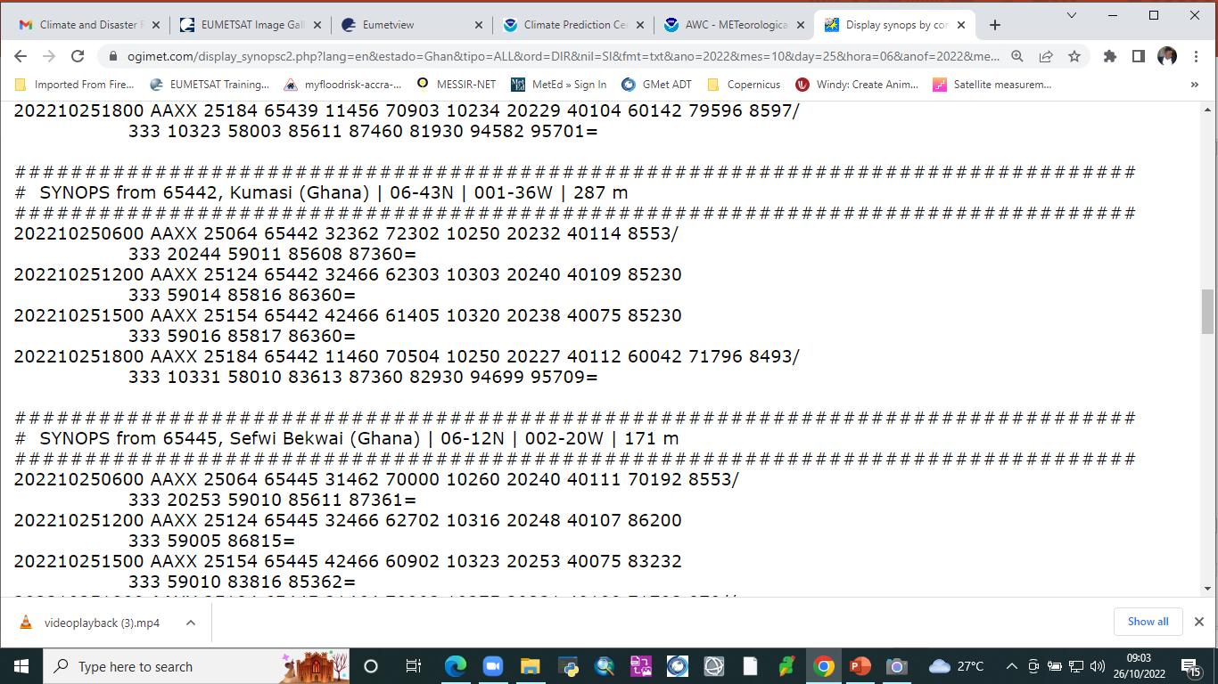
TERMINAL AERODROME FORECAST(TAF)

Slide 3
TIPS TO INTERPERATE TAF
AAXX- land feature
25064 – wind speed was measured
25063 – wind speed was estimated
CODES FOR LOCATIONS
65 – West African , 422- KUMASI
472 – Accra , 445 – Sefwi Bekwi
VISIBILITY
32362 - 62>50; 62-50=12km
32343 - 43<50; 4300ft
WINDS(range =+-20)
N (0,360) E(90)
S(180) W(270)
INDICATORS
1 – air temp 2 – dewpoint temp
4 – pressure 5- pressure comp
6 – rainfall Amt 8 – cloud
7 - kind of weather happening
For air temp and dewpoint temp;
0 and 1 infront of the atuall value means (+) and (-) respectively eg 10250(Airtemp is +25.0)
PRESSURE(4)
Eg. 40109=1010.9hpa , 49954=995.4hpa

Slide 4
TIPS TO INTERPERATE TAF
RAINFALL AMOUNT(6)
Eg. 60042 (004 = 4mm, 2-period of rainfall accumulation)
PRESENT WEATHER(7)
Eg 71796 ( 17 – present weather,96 – past weather )
17- thunder without rain
96- thunder and rain
CLOUD(8)
Eg 8553/(5 - Amt of lowest cloud, 5 - type of LC, 3 – type of MC , / - type of HC)
PRESSURE COMPARISON(5)
Eg.59011 – (9(-) or 8(+) ,011(The difference between current pressure and the pressure 24hr ago )
1foot = 0.3048m
1km = 0.6miles
27ft = hPa

Slide 5
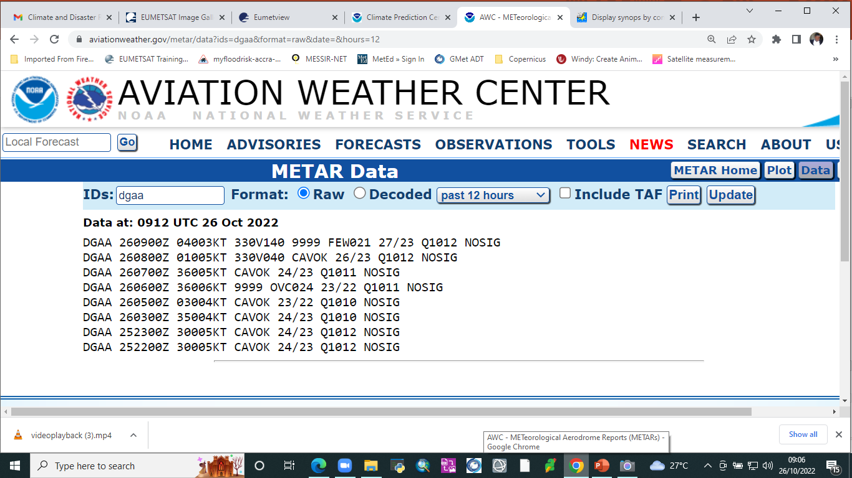
METEOROLOGICAL TERMINAL AERODROME REPORT(METAR)

Slide 6
TIPS TO INTERPERATE TAF
CAVOK (Ceiling And Visibility OK)
It indicates that there’s no cloud in the atmosphere at the time or no cloud is below 5000ft amd visibility is 10km or more
NOSIG(no significant change in the weather reported)
PRESSURE
Eg. 3016 means 30.16 inches of mercury for the pressure
CLOUD COVERS
i. SKC (sky clear)
ii. FEW (few, <1 to 2 oktas)
iii. SCT (scattered, 3 to 4 oktas)
iv. BKN (broken, 5 to <8 oktas)
v. OVC (overcast, 8 oktas)
vi. VV (sky obscured) [Clouds cannot be seen because of fog or heavy
precipitation, so vertical visibility is given instead.]

